Slide 1
Revision
Year 11
Week 1
Lesson 1

Slide 2
Topic: Earning an Income
Date
EQ – What are the different types of payment?
Salary: A fixed regular payment for professional or office work
Wages: A fixed hourly, daily or weekly payment for manual or unskilled labourers.
Contract: A contract of employment is an agreement between an employer and employee about the terms and conditions of employment.
Minimum wage: an employee’s basic rate of pay depends on such things as their age, job classification and the industrial award they are covered by.

Slide 3
Topic: Earning an Income
Date
EQ – What are the different types of payment?
Commission: is the sum of money that is paid to an employee once they have completed a task like selling car or house.
Fees: A fixed charge for a professional service for example a doctor or dentist

Slide 4
Topic: Earning an Income
Date
Daniel receives $3240 per month. Find his:
Annual salary
Weekly pay

Slide 5
Topic: Earning an Income
Date
For each of the following wage earning employees, calculate their hourly rate. Who earns the best rate per hour?
Tylor earned $5020 last month working 8 hours a day for 25 days
Alyssa earns $928 per week working 5 days a week from 9am to 5pm
Paris earns $826 for 35 hours of work

Slide 6
Topic: Earning an Income
Date
George works in a shop and is paid $12.40 per hour. Calculate George’s wage in a week when he works 40 hours.
Caitlin is paid $1845.90 per fortnight. If she works 35 hours per week, what is her hourly rate of pay?

Slide 7
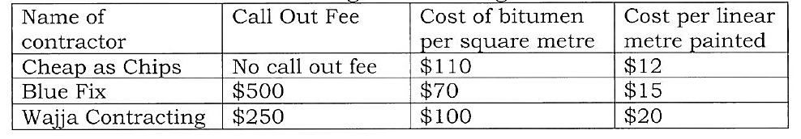
Topic: Measurement Contracts
Date
EQ – How does one get payment by contract?
The basketball court at school needs to be remodelled. This involves replacing the bitumen and painting new boundary lines. Three different contractors charge the following rates:

Slide 8
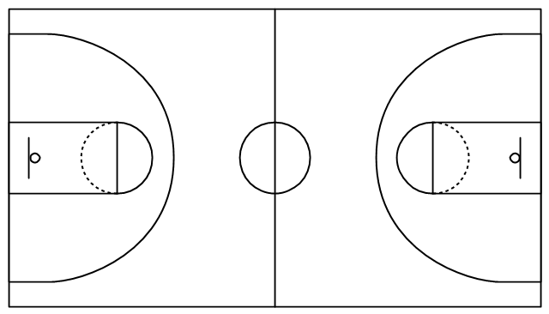
Calculate the area and perimeter of the basketball court.

Slide 9
Calculate the amount that will be charged by each contractor.

